Slide 1

French Society
The Estate Pyramid, City/Rural life and Louis XIV

Slide 2

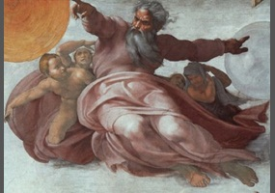
Who’s this guy?
IF you said god that is correct!

Slide 3
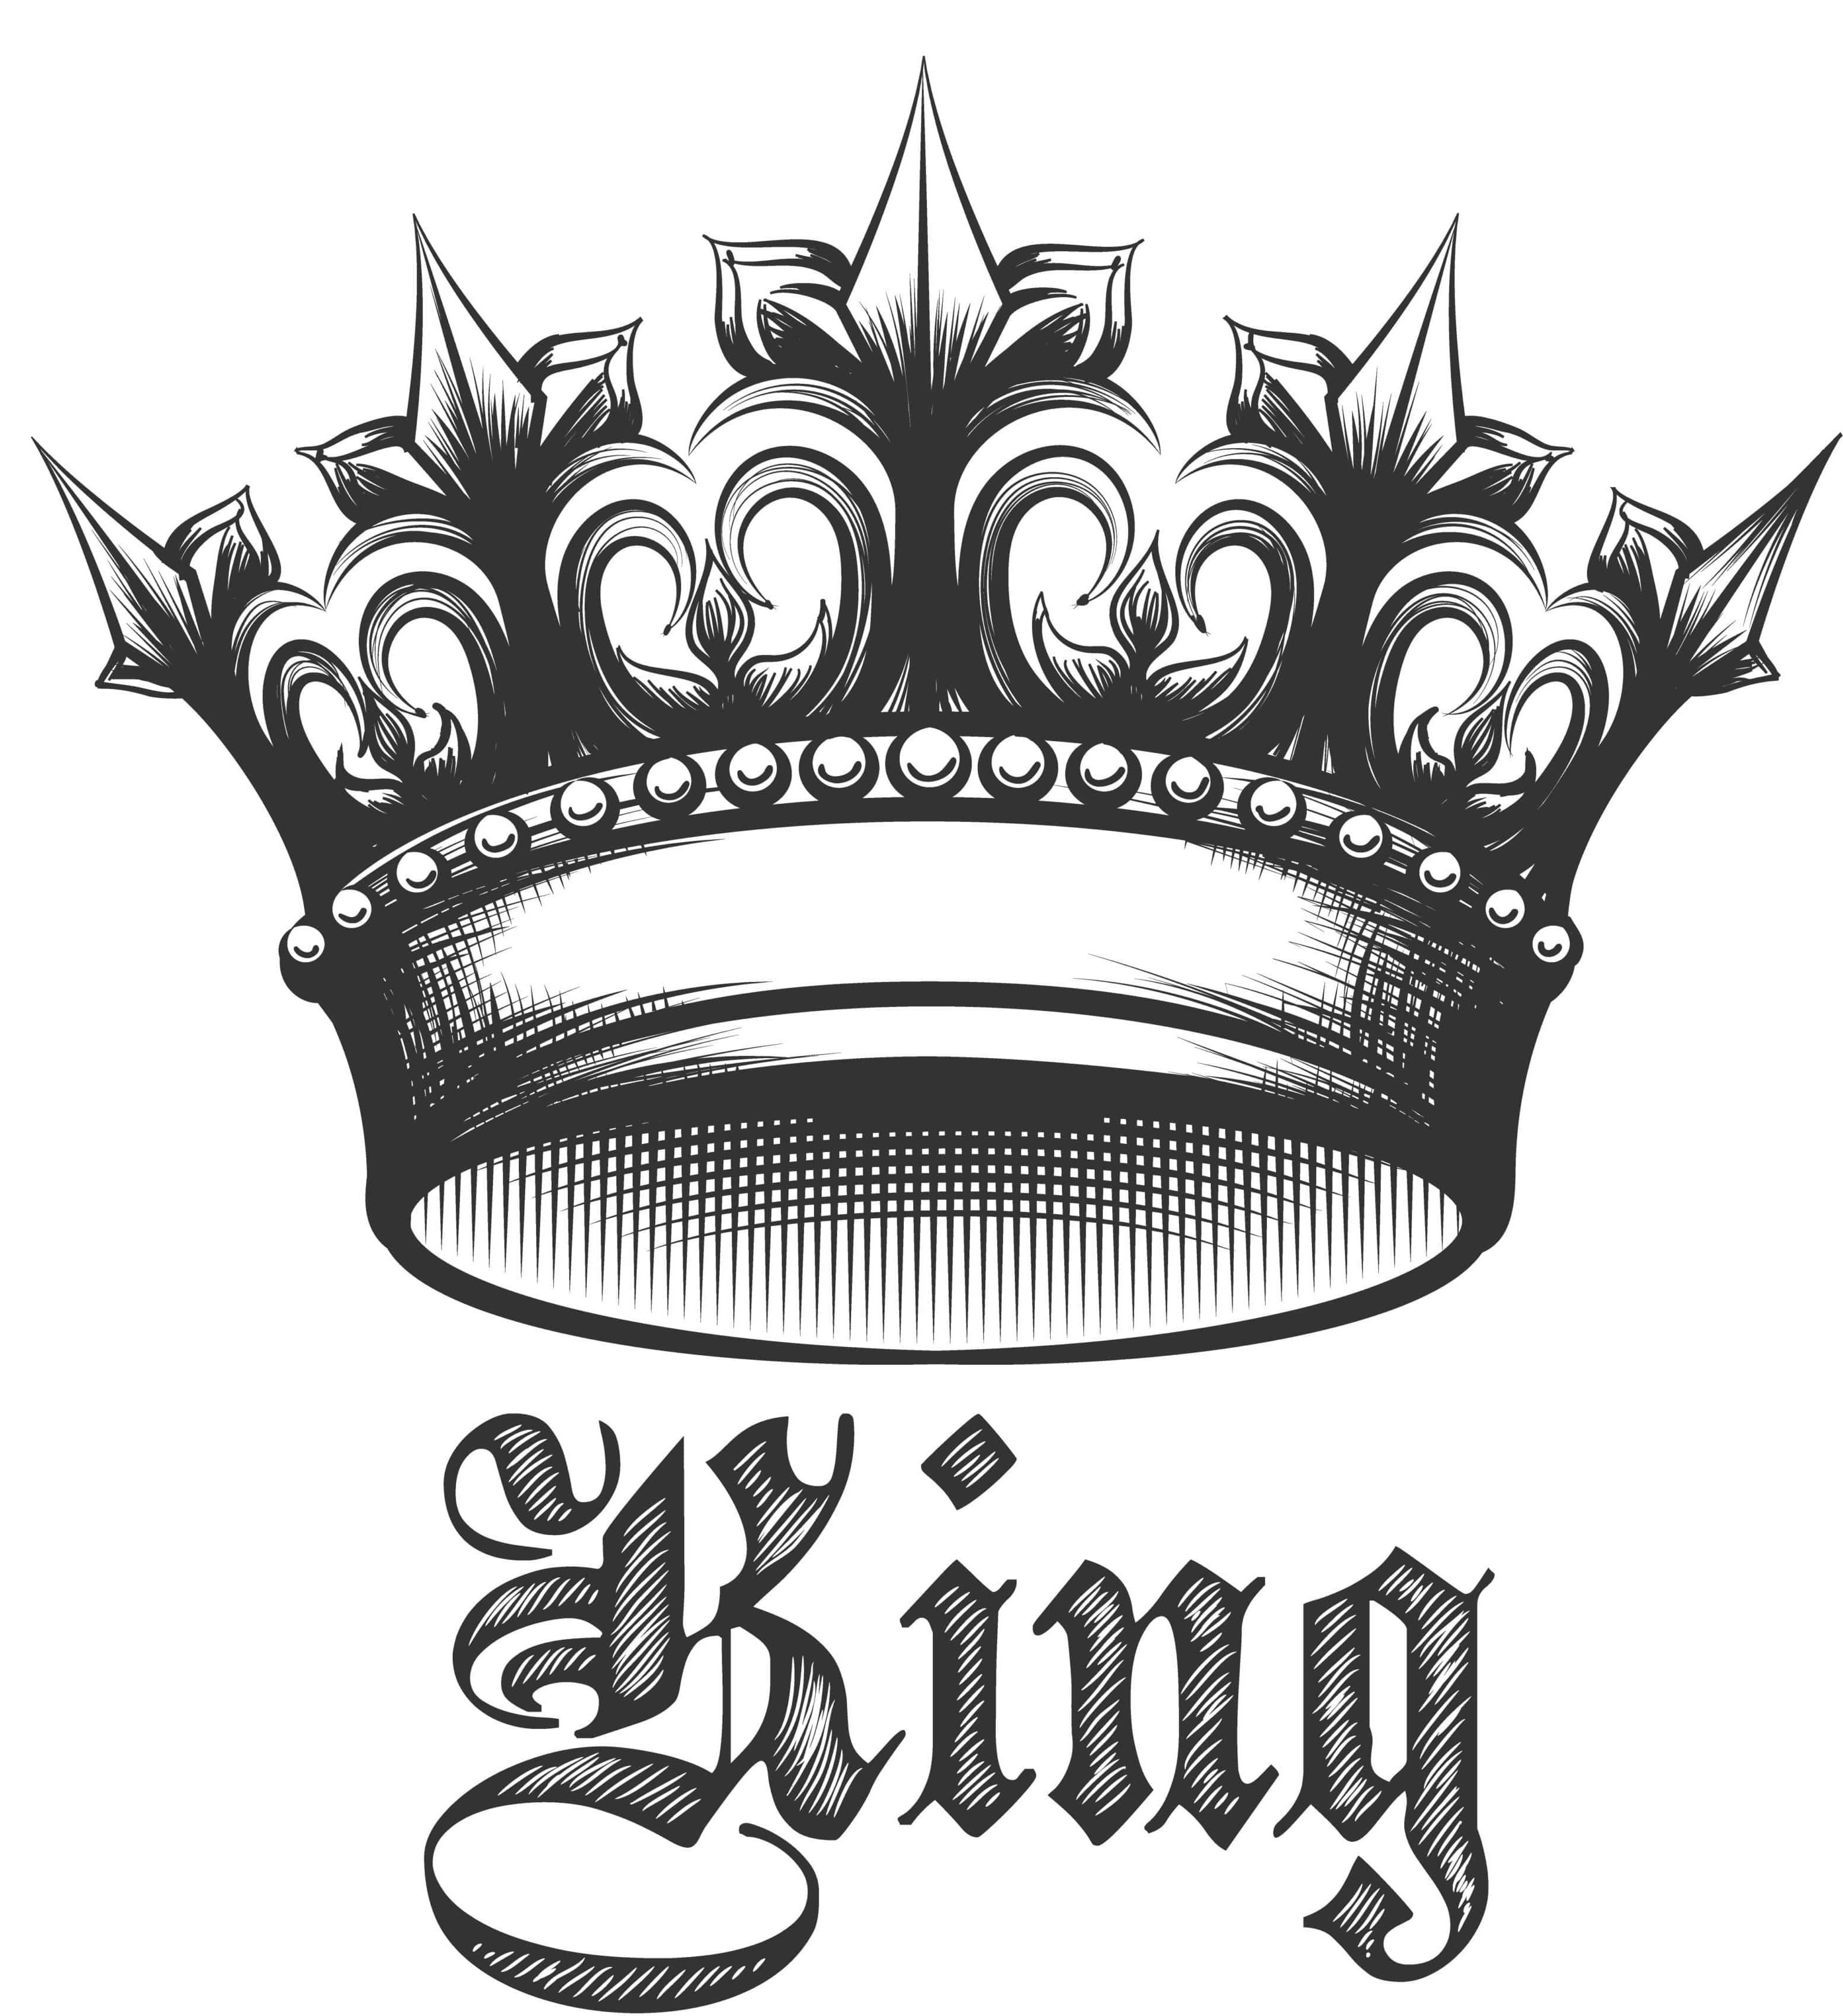
Who’s beneath God?
The King because it is his Divine right to be

Slide 4
3 Estate’s
Or Social Classes

Slide 5
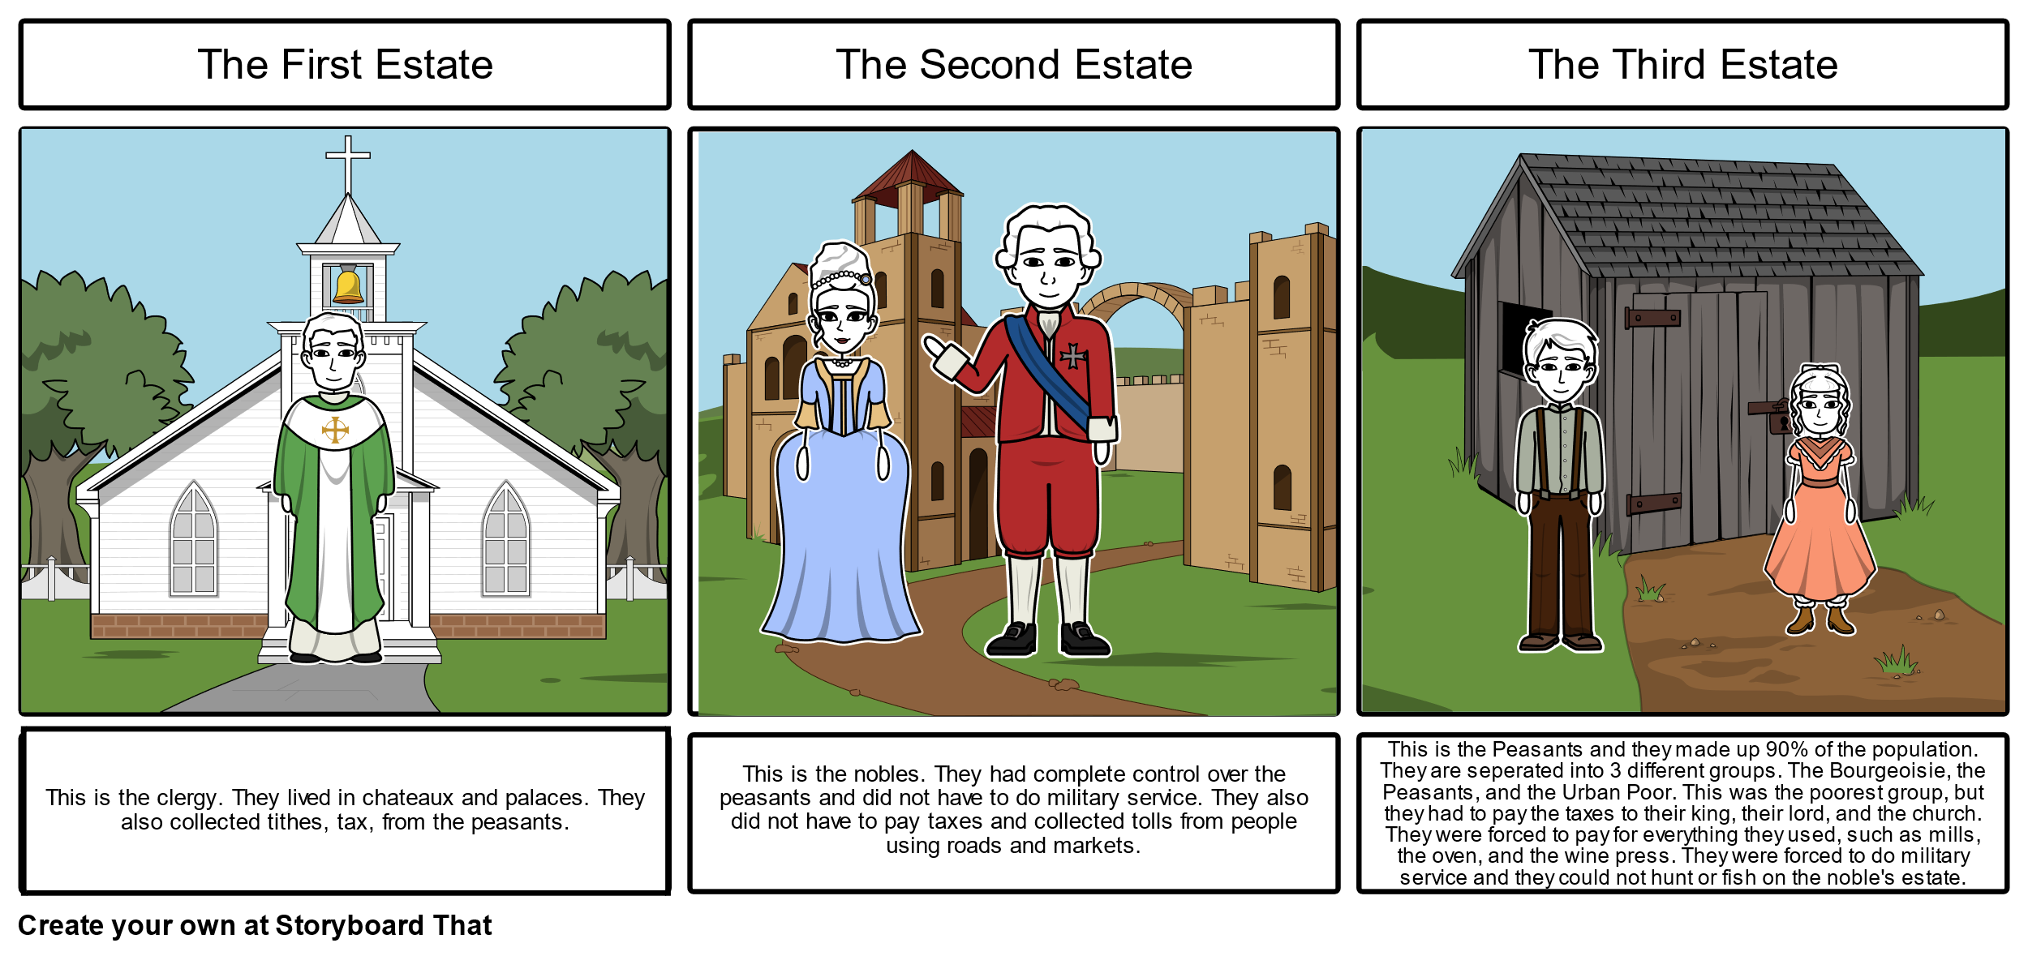
They only make 2.2% of the population
First Estate
These are the Clergy. Priests, nuns, monks etc.. They lived in chateaux and palaces and collected tax from peasants

Slide 6
They make up 1 % of the population
These are the Clergy. Priests, nuns, monks etc.. They lived in chateaux and palaces and collected tax from peasants
First Estate
These are the Nobles, they had complete control over the peasants and did not have to do military service. They also did not have to pay taxes and collected tolls from people using roads and markets.
There were two kinds of Nobles, those that were born Nobles and those that received status from the king in return for services or money. They were called “Nobles of the Robe”
Second Estate
They LOVED to party

Slide 7
Made up 97.8% of the population!!
First Estate
These are the Clergy. Priests, nuns, monks etc.. They lived in chateaux and palaces and collected tax from peasants
These are the Nobles, they had complete control over the peasants and did not have to do military service. They also did not have to pay taxes and collected tolls from people using roads and markets.
There were two kinds of Nobles, those that were born Nobles and those that received status from the king in return for services or money. They were called “Nobles of the Robe”
Second Estate
Made up of everyone else, from the wealthiest banker to the poorest farmer! The peasants worked the land, and the bourgeoisie were merchants and business owners.
Peasants were typically very poor and taxed the HEAVIEST!
Third Estate

Slide 8

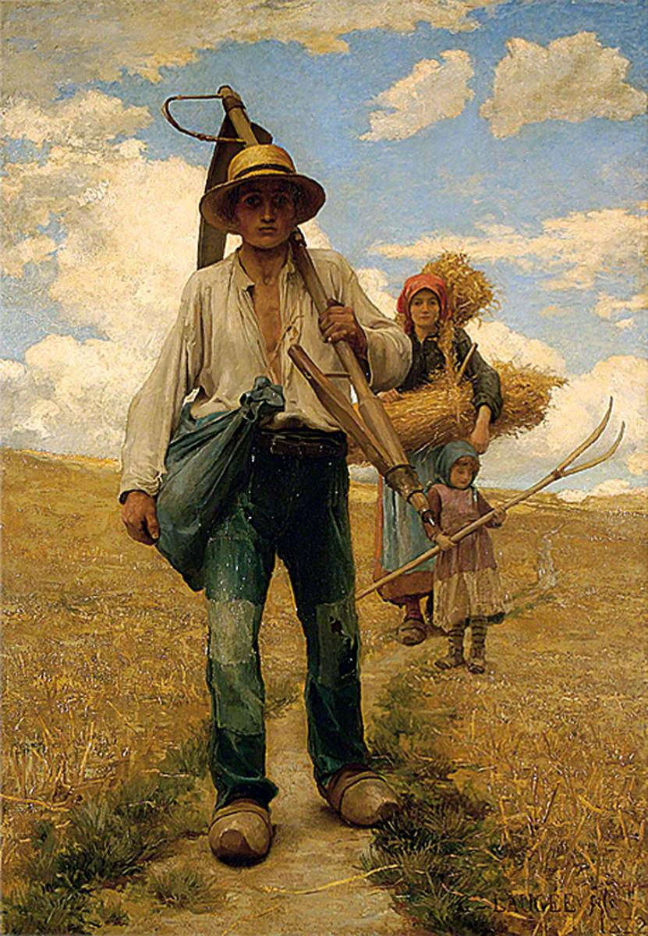
Peasant Life
To put it into perspective - 4 out of every 5 people in France farmed for a living.
Many owed the bulk of their produce to the seigneur. What is the Seigneur? Remember from our notes
French farmers aka the peasants, held small plots of land.
Few could read or write
No access to education
They lived a very brutal life, they worked very hard and had little to show for it. Talk about working yourself to death.
Landowner or feudal lord

Slide 9
Peasant Life
Peasants were often victims to of epidemics and famine, they were superstitious about life.
They spent most of their time working on the lord’s property and on government projects instead of their own small piece of land or else they would have to pay special fees to nobles.
They were forbidden to kill or drive off animals that killed livestock or destroyed crops, because these animals were often hunted by nobles for recreation.
Some of the hunts would ride through planted fields, damaging the crops – the peasant would then have to fix it or risk not having enough food for themselves after they give the rest to the nobles.

Slide 10

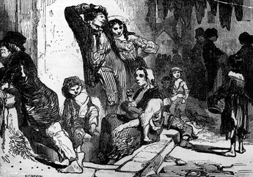
City Life
A guild /ɡɪld/ is an association of artisans and merchants who oversee the practice of their craft/trade in a particular area.
Paris was the hub of the country, with a population of around 600 000 in the 1700s.
Most people living in Paris had recently come from the country looking for work
GUILDS unfortunately controlled the work in French towns and cities
It was very hard to become a guild, thousands of workers without memberships worked low paying jobs IF they could even find work
Those that had good jobs had to spend most of their money on food, as food was very expensive.
Which meant, many people lived in SLUMS!

Slide 11



City Life
Paris was filled with beggars, vagrants and thieves
Everyone rich and poor had to deal with inflation. In the 1780s things were made worse by the crop failures throughout France.
Flour and Bread were very expensive! Which was a burden as bread was a stable diet to French people
In particular, What kind of bread? Is there anything else you know is particular for a French person to be known for to eat?

Slide 12

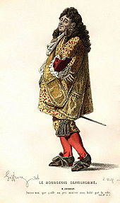
Bourgeoisie
The Bourgeoisie were an important part of the economy, they invested in new businesses and provided goods and services.
Laws and Regulations however, made it difficult for them to make a profit
Each district in France had its own internal tariffs and tolls
The lack of decent roads and canals only made the situation worse for business owners- who found it difficult and expensive to move goods around the country.
They lacked infrastructure
What is infrastructure? – check definition notes

Slide 13

Bourgeoisie
Although you could gain Nobility of the Robe their ability to participate in government did not increase. A small group of Nobles from ancient families controlled the most important offices in government.
The King and his inner circle of “true” aristocrats were awfully snobbish
They could not imagine giving up anything to people of lower rank than them

Slide 14


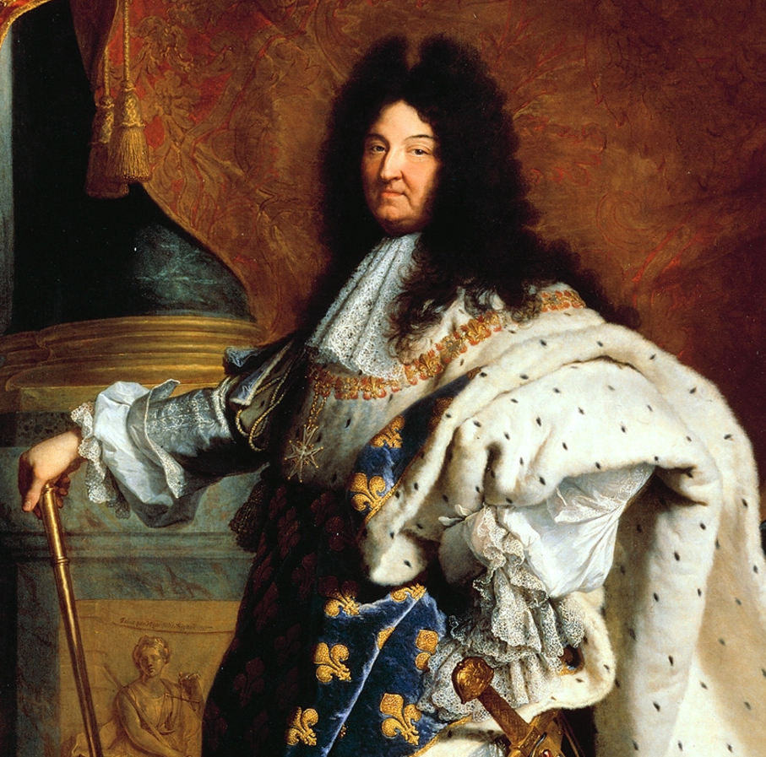
Louis XIV (14th)
By the 18th century, France was one of the largest and richest countries in Europe! It did however have economic and political problems..
Many of these problems resulted from the actions and inactions of the kings of France who seemed unable and unwilling to make the changes necessary to fix these problems.
What do you think? Afros have been around for a long time! (if you can call it one)

Slide 15
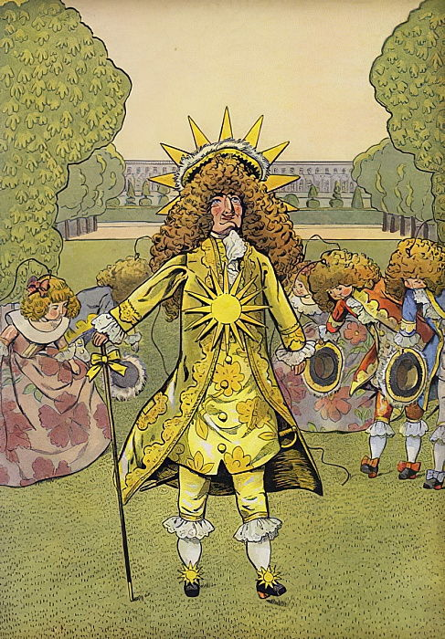
Louis XIV (14th)
Louis XIV ruled France for 72 years!!!! From 1643-1715. He saw himself as the center of French life and culture.
He believed he was the source of all light in the nation, and he was known as the “Sun King”
The phrase L’etat c’est moi (“I am the state”, or “the state is me”) reveals how highly he thought of himself to his relation to the country.
His word was law- he was the government, he made laws solely on his own judgment!

Slide 16
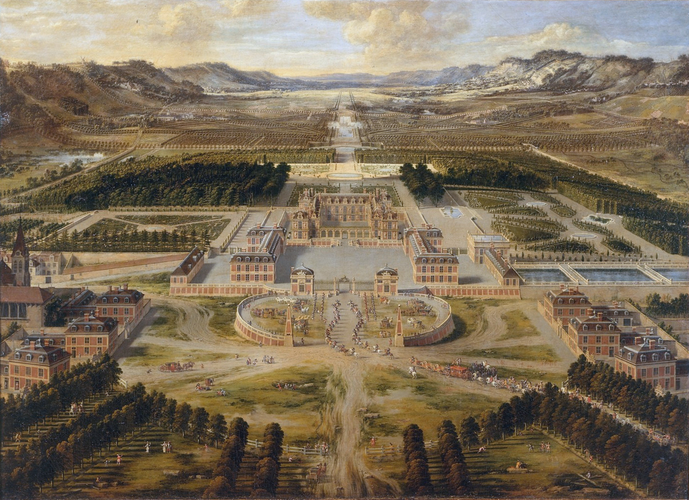
Versailles
In 1661 King Louis XIV began expanding a hunting lodge southwest of Paris into a vast palace
The palace and gardens of Versailles took several decades to perfect and cost an enormous amount of money
Louis moved his government there in 1682 long with important Nobles so he could watch over and control them
These nobles were invited to the royal getting up, the royal breakfast, the royal lunch, the royal supper, the royal going to bed and everything in between.

Slide 17
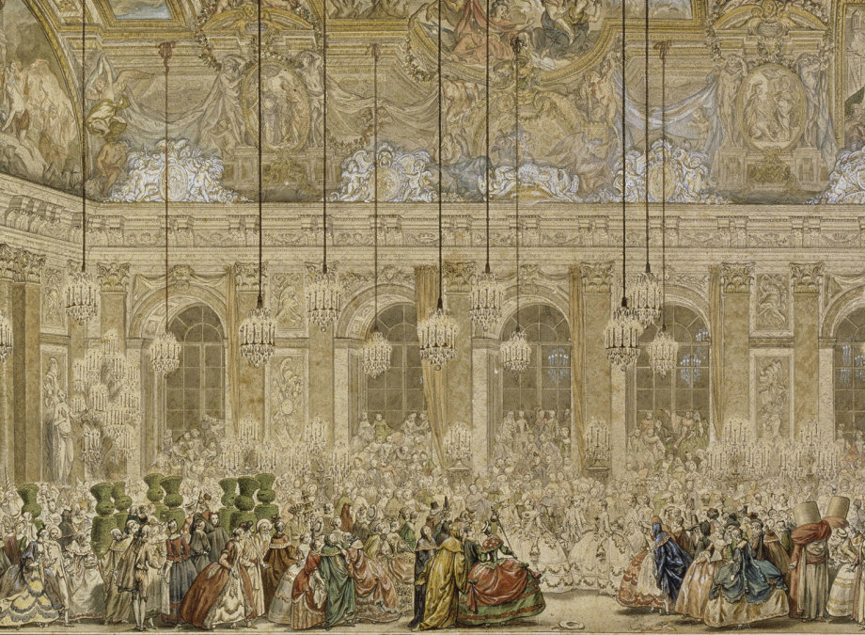
Versailles was luxurious, beautiful, and isolated
As a result, the nobles and the royal family had little knowledge of the everyday realities happening everyday in France.

Slide 18
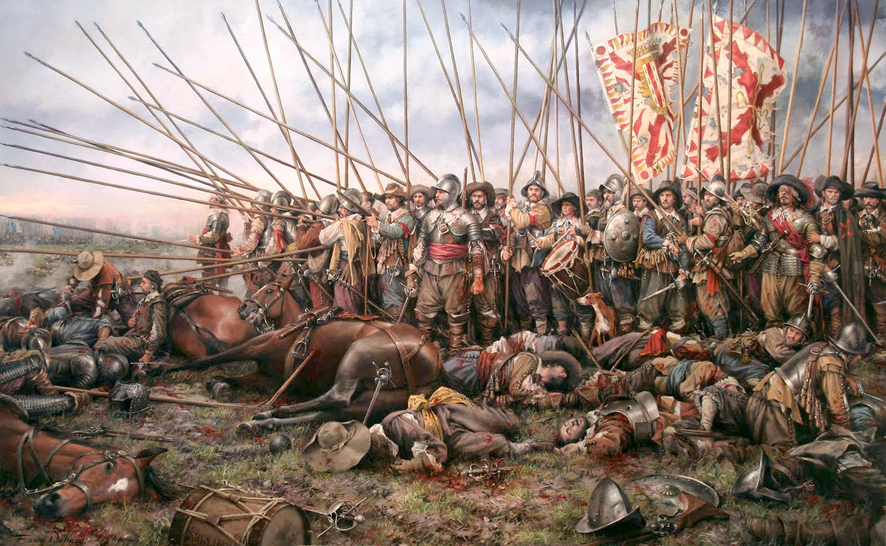
Louis involved France in several wars to promote his own interests and expand French territory. Wars with the Spanish and Dutch expanded territory but depleted the Treasury

Slide 19
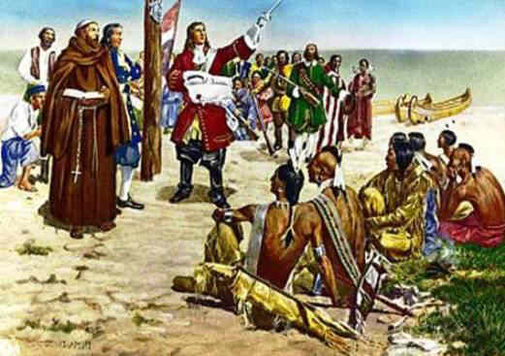
French colonies were established in the America’s, in Africa and in Asia
French explorers claimed the Mississippi region for France calling it La Lousiane (Louisiana)
France was feared and despised by other countries in Europe. As a result, many former allies began to turn their backs on Louis and France.

Slide 20
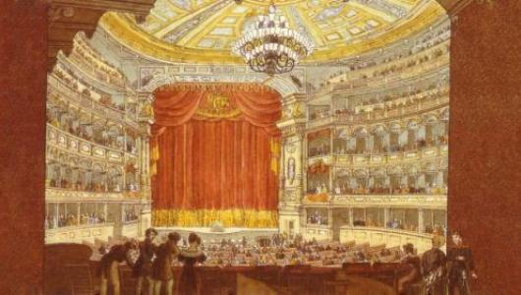
Enriching French Culture
Louis was a major patron of the arts. He supported the musician and composer Jean-Baptiste Lully, who created French Opera
https://www.youtube.com/watch?v=cB2qGfyzJRU

Slide 21
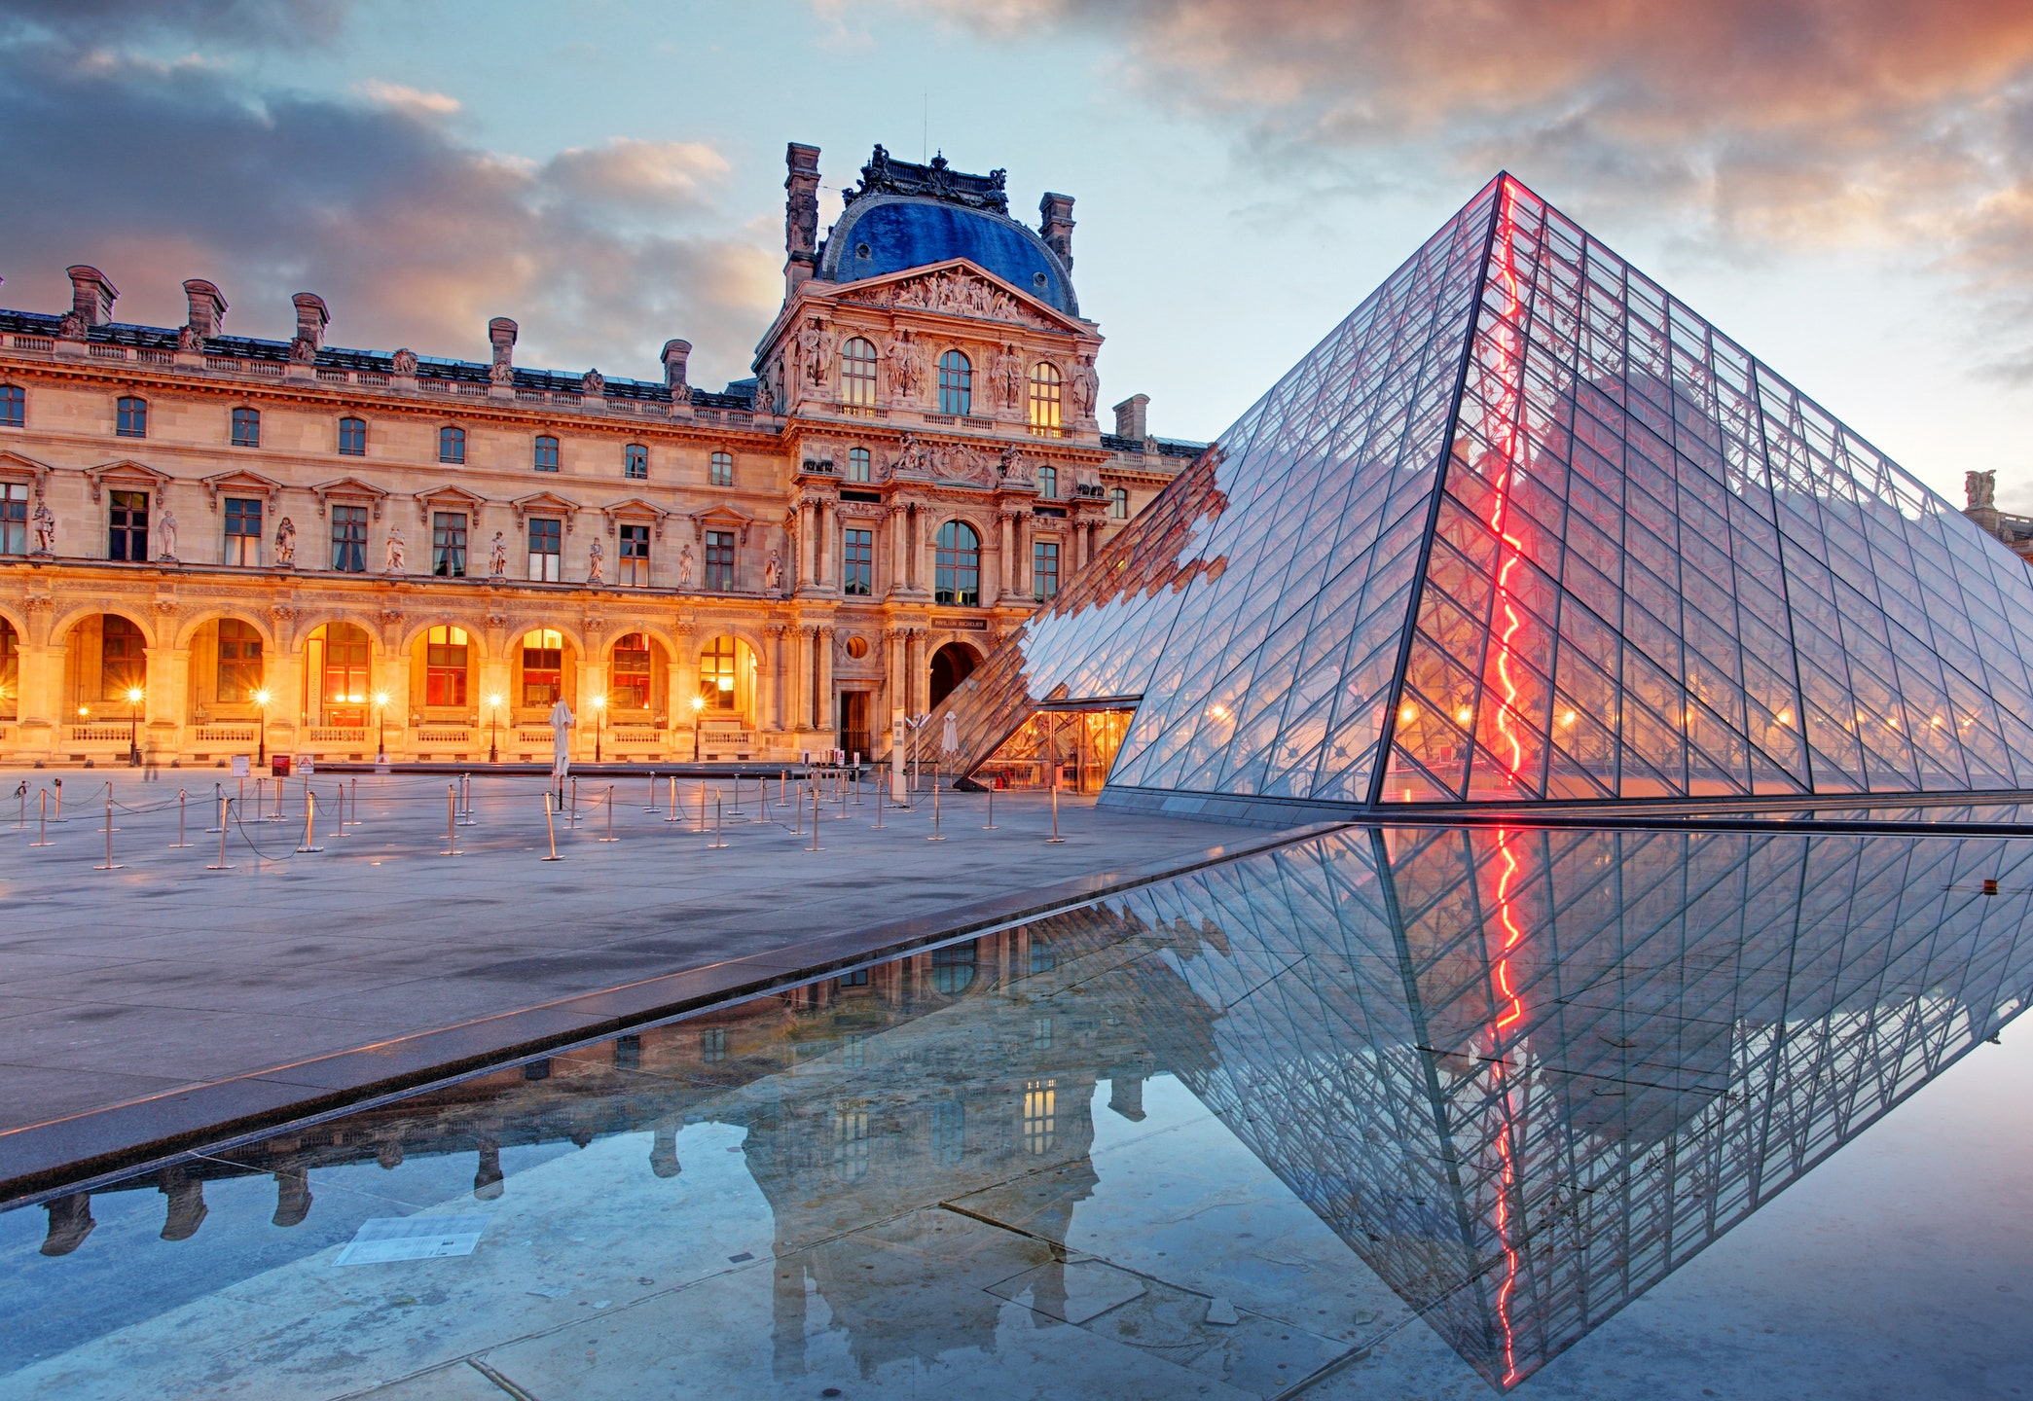
Enriching French Culture
He supported writers and painters and made certain ones very very successful based on his liking of their pieces. When Louis moved from the Louvre Palace in Paris to Versailles, he made the Louvre an art gallery! That you can still visit today!
Anyone every heard of the Louvre?
French art, architecture and cooking became the standard by which all others were judged.
Other European rulers copied the palace of Versailles and hired French tutors, dancing masters, composers and fencing instructors.
French became the language of cultured people throughout Europe.

