Slide 1
How did revolution lead the colonies towards independence?

Slide 2
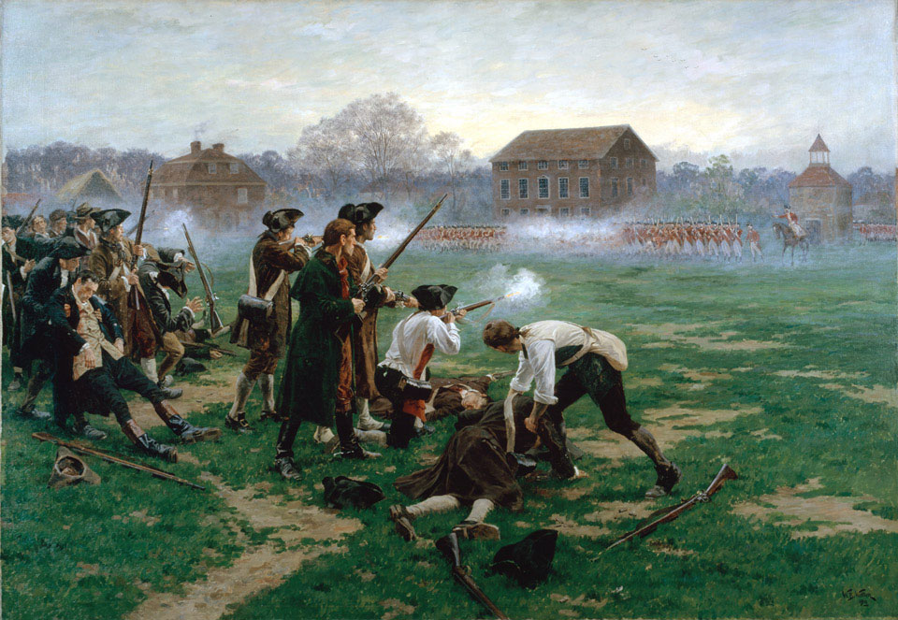
The opening shots of the revolution were fired on Lexington Green in Massachusetts. British and American soldiers faced off against one another.
What do you notice in this picture?
How are the battle tactics different than WW1?

Slide 3
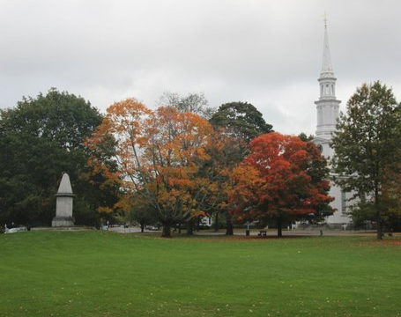
Lexington Green
Where the first battle took place is now a state national park with monuments and every year there is a reenactment of the battle
Lexington Green Reenactment Video
https://www.youtube.com/watch?v=h0Dc5QHeT4g

Slide 4
“The shot heard around the world”
As the two armies lined up to face one another tensions were rising, the British commander told the American’s to leave and told his men not to fire.
With tensions high between the groups a shot was fired, causing the British army to open fire on the Americans
The American’s
fled, few were killed or wounded
The British Army was attacked by a militia force on their way back to Boston
STARTING THE AMERICAN REVOLUTION!!

Slide 5
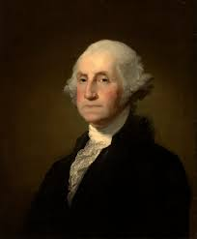
The Americans knew they needed to build a substantial army to have a chance against the British force
George Washington and other colonial leaders banded together in a cause to fight for their freedom creating the continental army
They held their own against the British at numerous battles and George Washington was named the commander of the army.

Slide 6
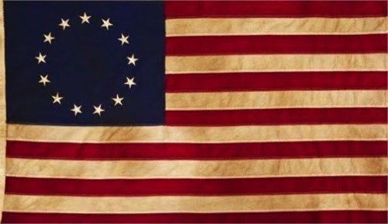
Branding the Revolution
Revolutionary leaders used symbols and other devices to focus revolutionary ideas and help people identify with them.
The Star-Spangled Banner was one of the first goals of the revolutionary government. The flag would unite them together, it had 13 bars and 13 stars in a circle to stand for the 13 colonies uniting together for their independence

Slide 7
The Liberty Bell
Was cast for the Pennsylvania Legislature, is said to have been rung when the Declaration of Independence was announced in 1776.
The words “Proclaim Liberty thro’ all the Land unto all the inhabitants thereof” is etched on the surface
What does this mean in your eyes?
What is it saying

Slide 8
The Liberty Bell's inscription is from the Bible (King James version): "Proclaim Liberty Throughout All the Land Unto All the Inhabitants thereof." This verse refers to the "Jubilee", or the instructions to the Israelites to return property and free slaves every 50 years. Speaker of the Pennsylvania Assembly Isaac Norris chose this inscription for the State House bell in 1751, possibly to commemorate the 50th anniversary of William Penn's 1701 Charter of Privileges which granted religious liberties and political self-government to the people of Pennsylvania. The inscription of liberty on the State House bell (now known as the Liberty Bell) went unnoticed during the Revolutionary War. After the war, abolitionists seeking to end slavery in America were inspired by the bell's message.
US Department of National Parks service

Slide 9
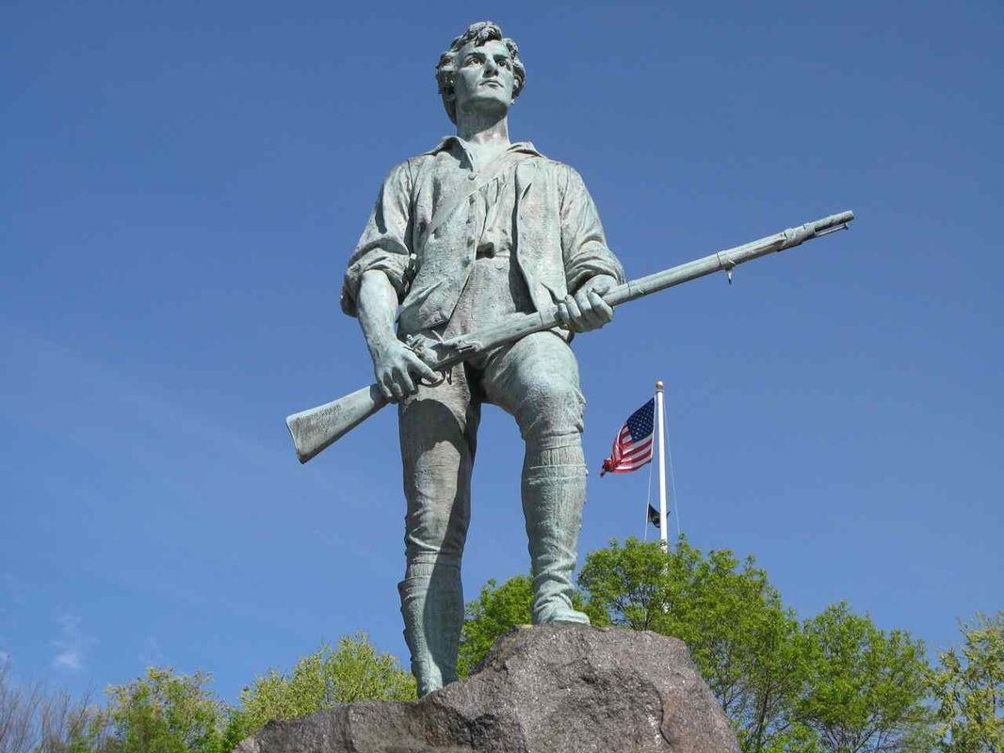
The Minuteman
A revolutionary war soldier is the symbol for the Americans willingness to fight for freedom.

Slide 10
Attack on Quebec!
The Leaders of the Continental congress looked first at how they could defend their northern borders.
They knew pretty troops could come through Quebec to attack them; they knew they had two options:
They could try and convince Quebec to join the revolution
Attack first and claim Quebec for themselves
Richard Montgomery and Benedict Arnold tried in the winter of 1775 and failed, which lead Quebec to maintain Loyal to Britain

Slide 11
Deciding what to do
While the fighting was continuing on the battlefields, the delegates of the continental congress continued to meet to figure out what exactly they were wanting out of this war. Was it complete independence? Or a constitutional monarchy?
Some of the delegates believed each state should have its own government and they are only working together to achieve that from Britain

Slide 12
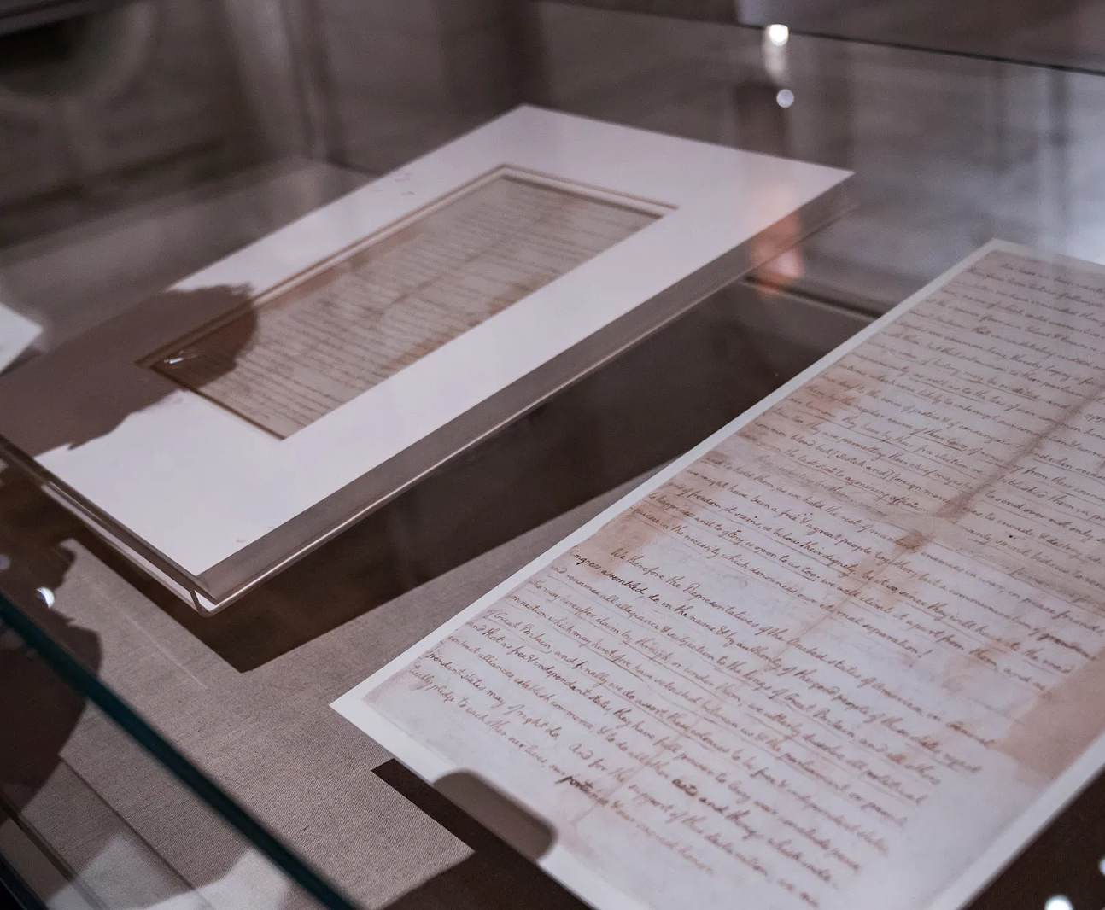
The Declaration of Independence
The three most famous individuals who agreed on independence from Britain you may have heard of: Thomas Jefferson, Benjamin Franklin and John Adams
Together they drafted a statement that would declare independence from Britain which became known as
The Declaration of Independence.

Slide 13
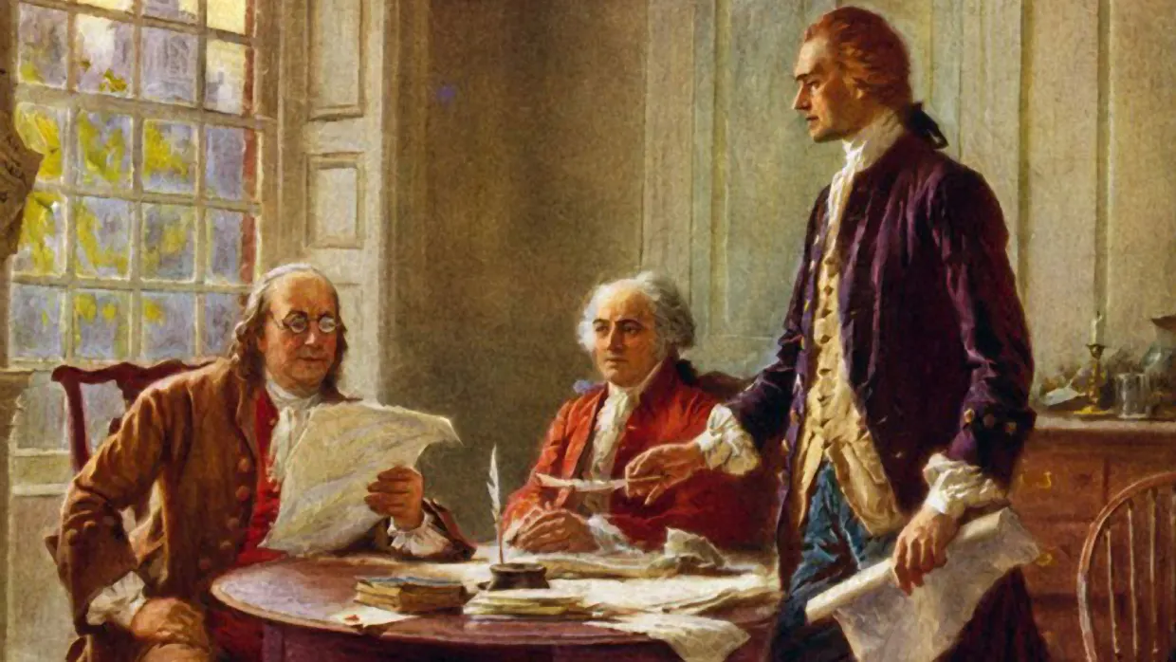

Slide 14
The American Declaration of Independence is is one of the most revolutionary documents in world history. It proposed the United States as a new nation that believed people had rights that no government could take away. (which is a reason today why so many fight for their right to bear arms as its written in the constitution)

Slide 16
The Declaration never ended the war, the war continued on for 7 years, Spain and France joined the American cause and together they defeated a whole British army and drove the last of the British forces out of New York and the United States.
The Declaration of Independence inspired others to strive for similar outcomes, the revolutionaries in France overthrew King Louis XVI (16) less than 20 years later 1792.

Slide 17
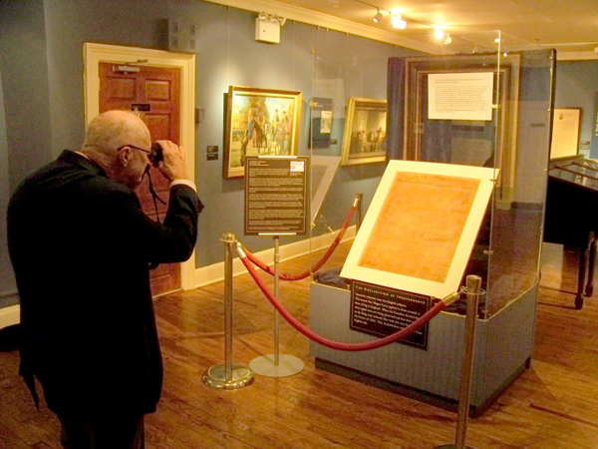
The Declaration of Independence is on display at the National Archives building in Washington DC.

