Slide 1
Intro to the American Revolution
How did the 13 colonies
come to revolution

Slide 2
England, France and Spain were in a fight for territory in North America
Having colonies in America was very attractive to Britain it could provide many resources;
Furs
Timber
Gold
This Photo by Unknown Author is licensed under CC BY-NC

Slide 3
Colonies would be a great opportunity for poor, troubled and landless people to start a new life
Building a settlement in a new area of the world is tough, they did not know the climate or the fertility of the area
Many people struggled to establish themselves there
People starved and died of disease
As well, froze to death in the winter from the harsher weather than they experienced in Britain

Slide 4
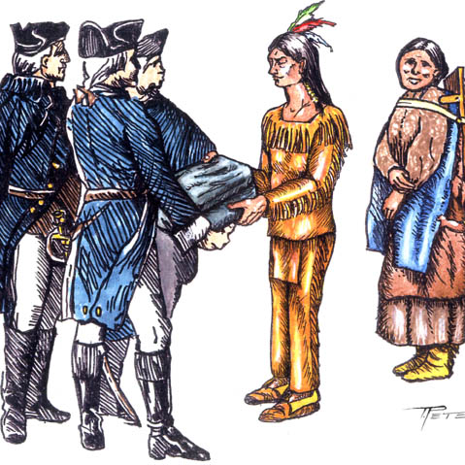
Some colonists negotiated trade relationships with near by Indigenous tribes
These relationships also brought new diseases for Indigenous people such as; smallpox, measles, Influenza
Warfare between tribes for trading with the colonists and warfare with the colonists for the taking of their land

Slide 5
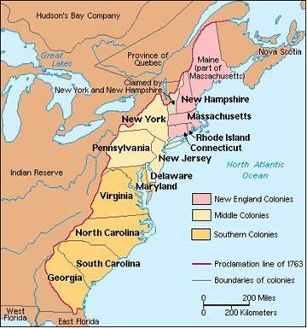
13 Colonies
-England established 13 colonies along the eastern coast of north America from Maine to Georgia
-Each of the 13 colonies were founded at different times for different purposes
-Each colony had its own government and a colonial legislature
-Some colonies were founded for economic reasons (Virginia)
-Some for religious (Massachusetts and Maryland) or refuges

Slide 6
Independently operated with little in common
Many of the leaders had never visited the other colonies
Each colony could thrive on their own economic goals and needs
However, the colonies were to provide their resources to Britain, which were used to manufacture goods
The goods were then sold back to the colonists……

Slide 7
By law, the colonies were not allowed to disrupt this flow of business
They could not create their own goods and develop economically
What problems did this create
for the colonies?

Slide 8
Made the colonies economically dependent on Britain.
They had a say in everything they did, and the colonies had the British army for support in their conflicts with New France
Britain made one big mistake
what do you think it was?

Slide 9
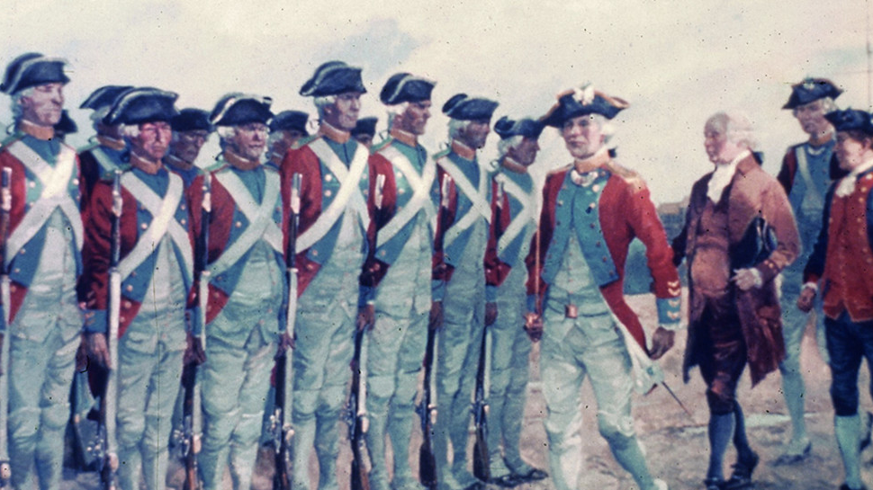
They eliminated the only reason the colonies needed an army for protection
They captured new France
Who would later help the colonists achieve independence from Britain and become America

Slide 10
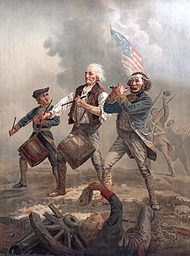
Why was American
independence so revolutionary?

Slide 11
Society was ruled strictly by the monarchs in this time period (18th century)
The wealth were the only ones who could vote or create laws
Which meant they only looked out for themselves, which made it hard for anyone to move up in social status

Slide 12
Britain was a big military empire that defeated France and Spain in battle for colonies and territory
A battle by the colonies for independence was something no one had much experience in or knew anything about
Britain was dumbfounded someone would think the empire owed the colonies anything, the colonies purpose was to provide for the empire

