Slide 1
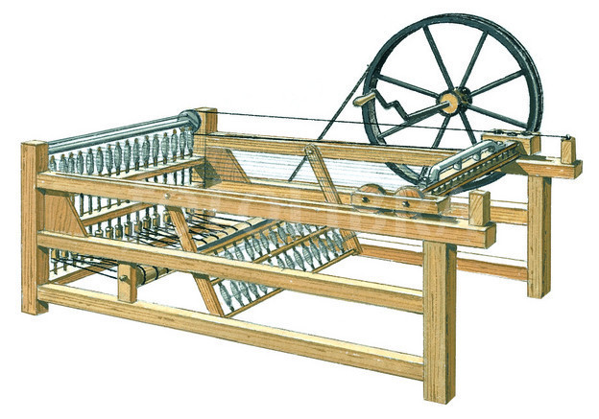
Inventions –Project

Slide 2
It is important to understand the significance of innovation and revolution to create change.
The Industrial Revolution was an important time of change for machinery and technology.
You must research your selected technology and include the following:
Name of technology & include at least 2 pictures
Name of inventor & where it was invented
What inventions were required to lead up to your invention? Demonstrate this by tracing back through time and showing the progression. OR What invention(s) did your invention lead to? Trace from your invention to an invention of today. Is the machine/device/technology still used today? If yes, where do we see it? If no, what has taken over in its place?
Its capability (what could it do, where was it commonly seen).
How it impacted (changed) the world & why it was important.
A video of the technology
Reference list with at least 5 appropriate/academic sources
Marked on Criterion B: Investigating and Criterion D: Thinking Critically

Slide 3
Possible Inventions
Steam Engine –
Telegraph –
Sewing Machine –
Transatlantic Cable –
Telephone –
Phonograph –
Incandescent Light Bulb –
Electric Motor –
Diesel Engine –
Refridgerator –
Airplane -
Model T-Ford -
Cell Phone -
Photography -
Elevator -
Spinning Jenny -
Microwave –
Insulin –
Concrete –
The Nail -
Electricity –
Battery –
Printing Press –
Steel –
Antibiotics –
Seed Drill –
Flying Shuttle –
Cotton Gin –
Iron Plough –
X-ray –
Rubber -

Slide 4
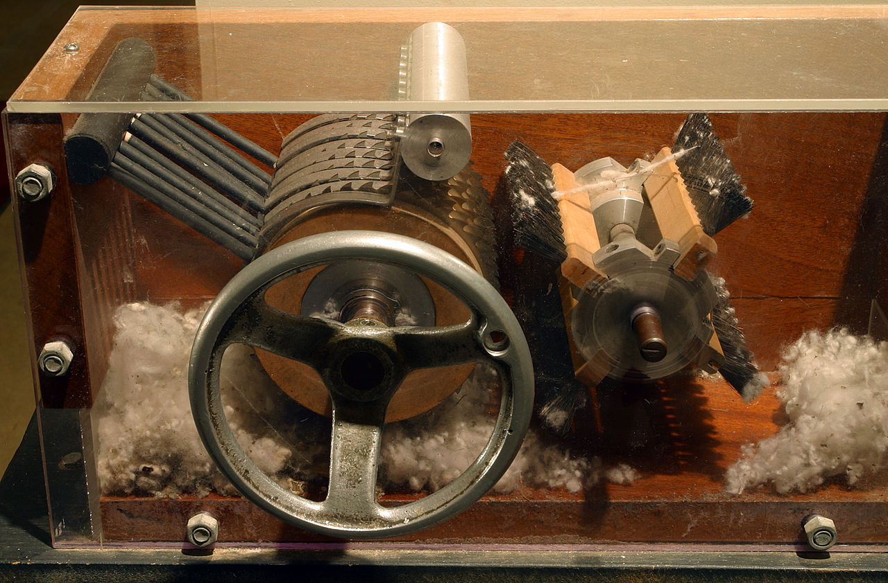
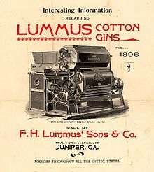
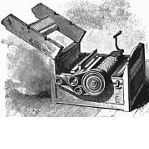
The Cotton Gin
Inventor - Eli Whitney (United States of America)
Capability - Allowed cotton to be separated quickly and effiiciently from the seeds. This was often used in southern states of the USA where cotton farms were common in the south. The model could clean 50 pounds of lint per day!
Inventions Leading From/To Cotton Gin - XYZ
Impact - By making the process more efficient businesses were able to make more money and process cotton quicker. This increased the demand for cotton worldwide. This also led to other machines being invented to increase efficiency in the textile industry (ex. Shirt making). This also led to more slavery as farmers were needing to produce more cotton and thus needed more workers for their farms.
Today - Modern cotton gins are large industrial machines which are increasingly not operated by humans. 33,000 pounds of cotton can now be processed in just one hour!!
Bibliography - “The Cotton Gin” - https://www.eliwhitney.org/7/museum/eli-whitney/cotton-gin
“Cotton Gin” - https://en.wikipedia.org/wiki/Cotton_gin
Cotton Gin Demo - https://www.youtube.com/watch?v=JzHD7_dWEik

